Slide 1
Powerful PowerPoint Slides
Rich Malloy
Tech Help Today

Slide 2
Why Use Moving Slides?
People enjoy videos
Static pictures are boring
Movement can convey more information

Slide 3
Note
A PDF copy of this slide show is at:
www.techhelptoday.com/videos
Or
bit.ly/library-101

Slide 5
Moving Backgrounds

Slide 6
Use Videos as Backgrounds
Click background of a slide
Click: Insert > Icon > Video
Choose a subtle video
Or, use an “animated gif” file
Click: Video Format > Send Backward
Until text is visible

Slide 7
CAUTION:
Video files are huge
Make sure text is readable
Use Shadows
Insert a transparent shape behind text

Slide 8
Moving Background Exercise
Create a moving background for this slide

Slide 9
Animation

Slide 10
Animation
Can make objects appear
Text
Shapes
Pictures
Best use: Annotation
, disappear
, or move

Slide 11
Annotations
Underlines
Arrows
Boxes
Circles

Slide 12
How to Animate Objects
Select the object(s) or text
Click the Animations tab
Choose the desired animation

Slide 13
Annotation Exercise
Annotate the text below using the shapes indicated
Underlines
Arrows
Boxes
Circles

Slide 14
Dimming Bullet Points
Each bullet point appears
And the previous ones are dimmed
Helps audience focus on current point

Slide 15
How to Dim Bullet Points
Show the Animation Panel
In the panel, select all but the last bullet point
Rt-click and choose Effect Options
Change After Animation to More Colors …
Choose a medium gray color

Slide 16
Morphing

Slide 17
Transitions
Easily animates the transition between slides

Slide 18
How to Add Transitions
Select slides
Click the Transitions tab
Choose a desirable transition

Slide 19
CAUTION:
Audience may view transitions as distracting
Use only when appropriate
Keep it simple

Slide 20
Morph — The Best Transition

Slide 21
Morph — The Best Transition

Slide 22
Morph — The Best Transition
The Easiest Way to Animate Slides

Slide 23
How to Morph a Slide
Choose a slide with a picture or shape
Rt-click it and choose Duplicate
In the duplicate, change the picture or shape:
Move it
Change its size it
Crop or uncrop it

Slide 24
Morphing Exercise
Crop the picture below to show just the face
Then have it morph into the full size picture

Slide 26
Merging Shapes
Create complex shapes by merging simple ones
Select all the shapes
Click: Shape Format > Merge Shapes
Choose: Union or Subtract
In Subtraction, the 2nd object is subtracted from the 1st

Slide 27
Merge Shapes: Example
Merge the blue shapes (Union)
Merge the yellow shapes with the blue (Subtract)

Slide 28
Merge Text with Shapes
Subtract the text from the yellow shape
Then move the new shape over the blue video
SOME TEXT

Slide 29
Zoom
Slides
Zoom
Slides

Slide 30
Zoom Slides
A great way to create a “Table of Contents”

Slide 31
How to Zoom
Select a blank slide
Click: Insert > Zoom > Zoom Slide
Choose the slides to include
Arrange the Zoom Slides as desired

Slide 32
Zoom Slide Exercise
Set up 3 Zoom Slides in the space below

Slide 33
Parliament

Slide 34
The Tower Bridge
From: User:Colin

Slide 35
The London Eye

Slide 36
Inserting Videos

Slide 37
YouTube Video

Slide 38
CAUTION:
Don’t just paste a video link on a slide
This will show the YouTube page
And video thumbnails based on your past viewing
https://www.youtube.com/watch?v=4p1rzw-7Jho

Slide 39
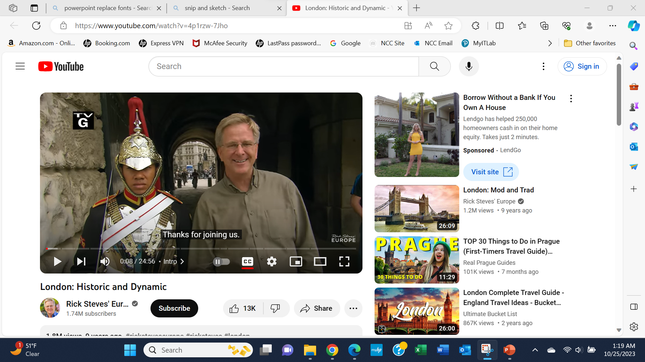

Slide 40
How to Embed a YouTube Video
In your browser, find the desired YouTube video
Copy the address at the top
Return to PowerPoint
Click: Insert > Video > Online Videos
Paste the address
Adjust the embedded video as desired

Slide 41
YouTube Video Exercise
In the space below, embed a video from YouTube

Slide 42
Adding Videos from Your Phone

Slide 43
Questions?
Rich Malloy
Tech Help Today
www.techhelptoday.com

Slide 44
Thank you
Rich Malloy
Tech Help Today
www.techhelptoday.com

